Slide 1
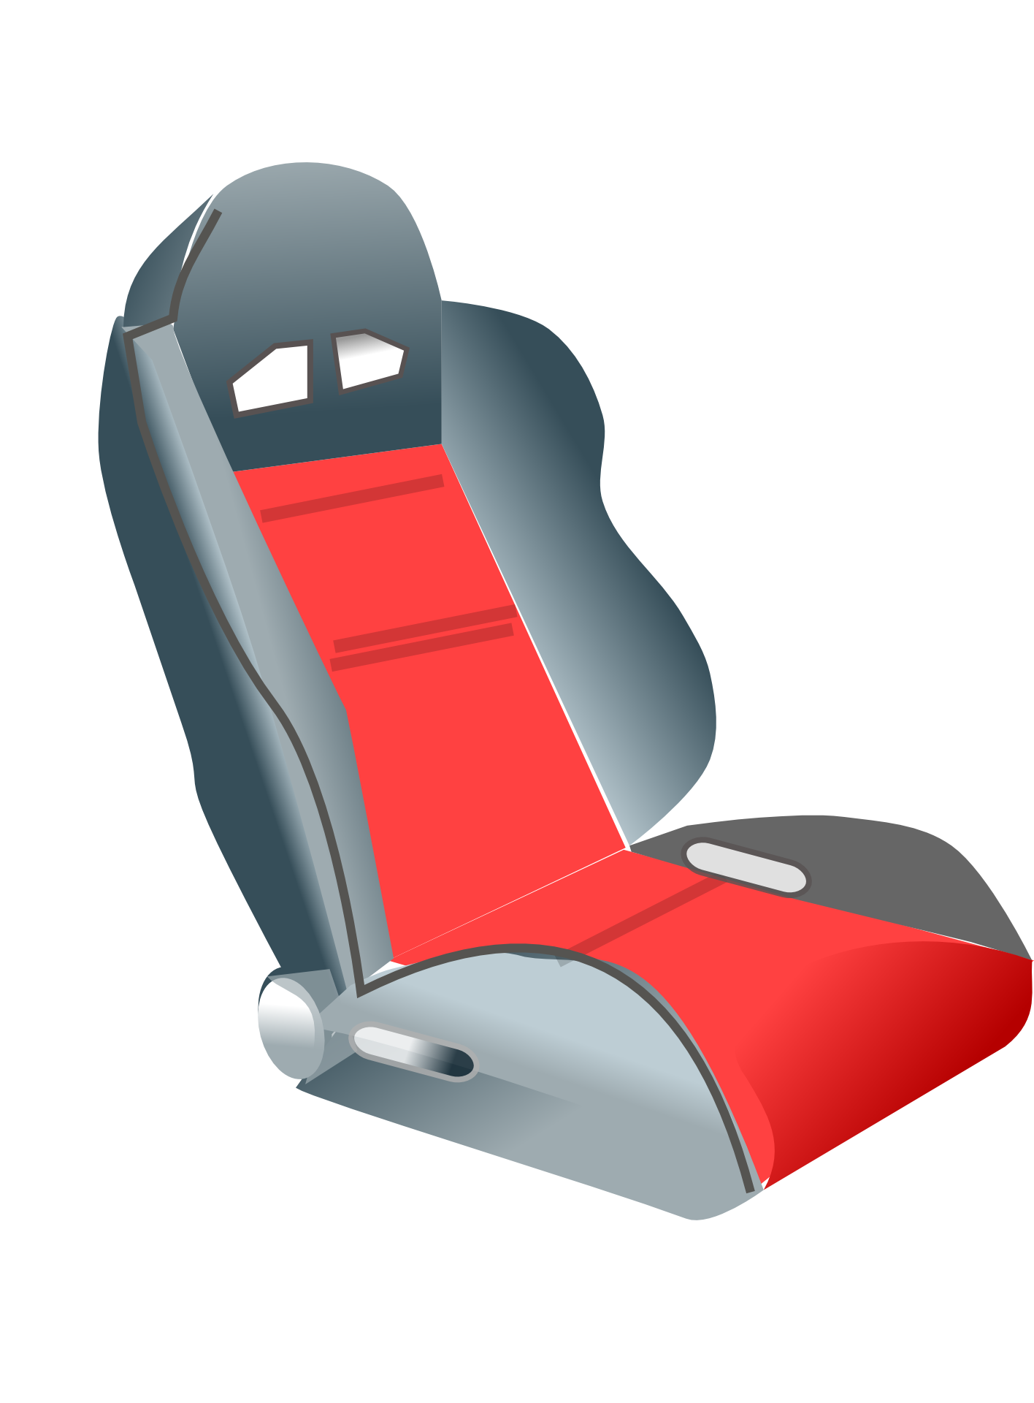

Massage
Team: Aixeraff, Alberto, Josep Maria and Josep

Slide 2
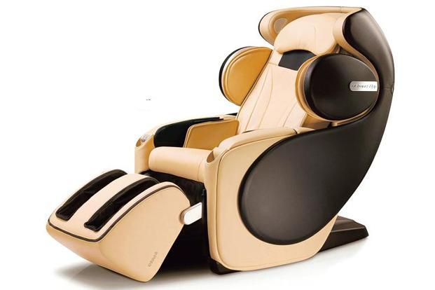
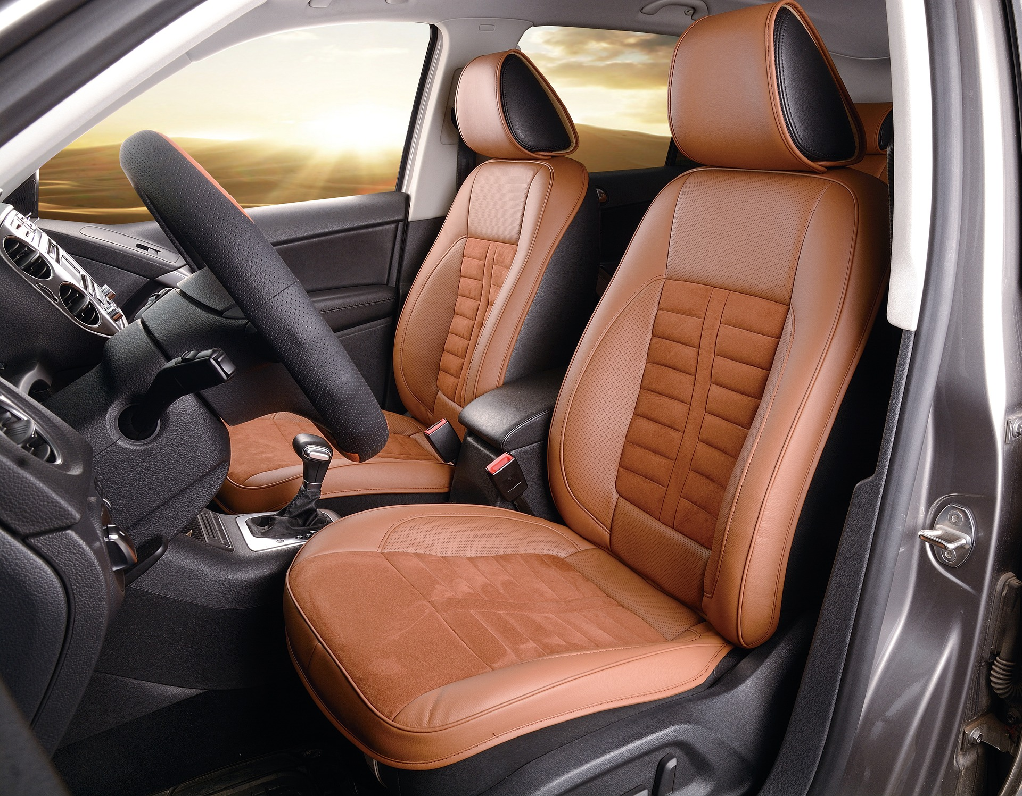

Same comfort, like at Home.

Slide 3
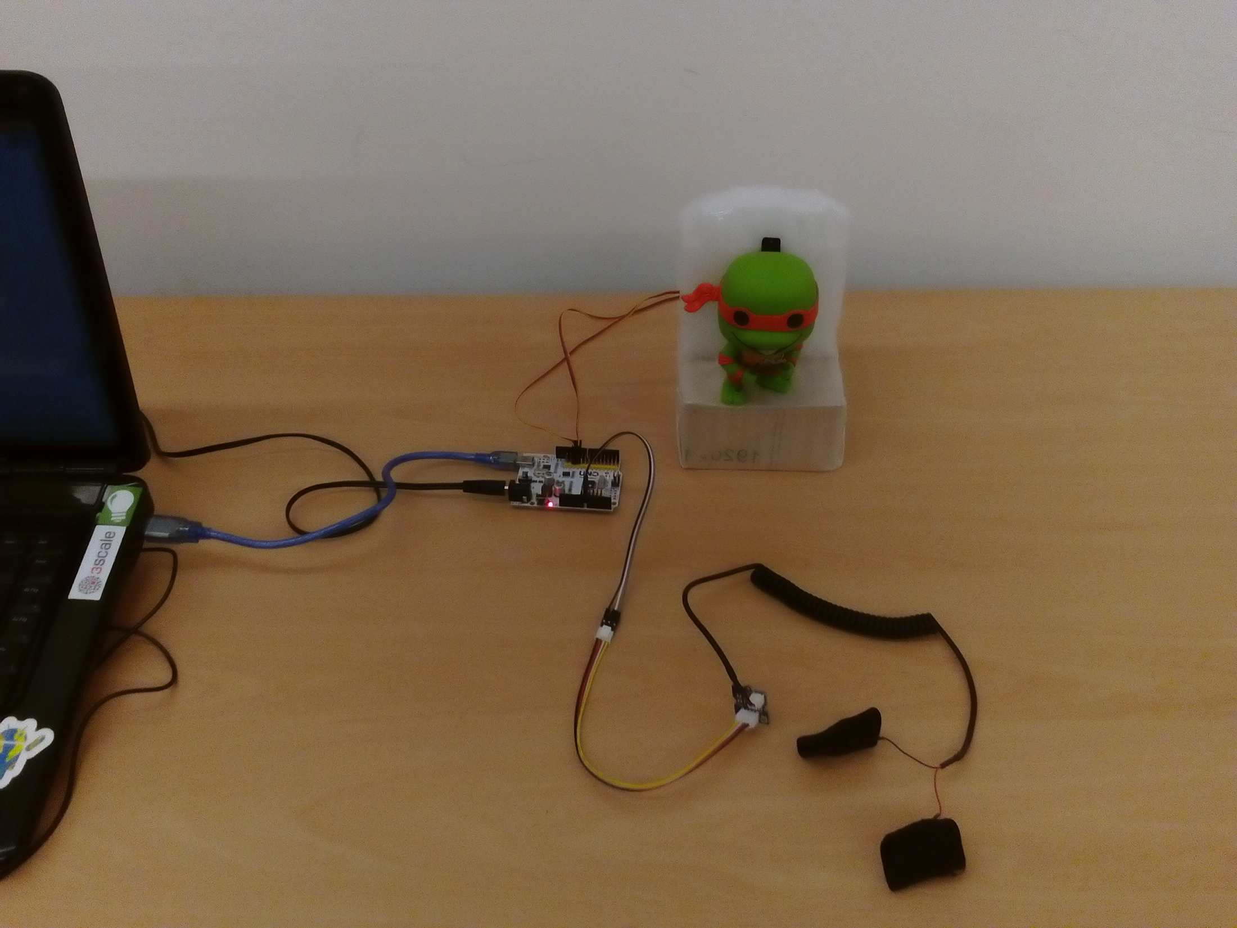
Stressed when you are in a Traffic Jam??. Even with automatic speed change
Massaging Michelangelo

Slide 4
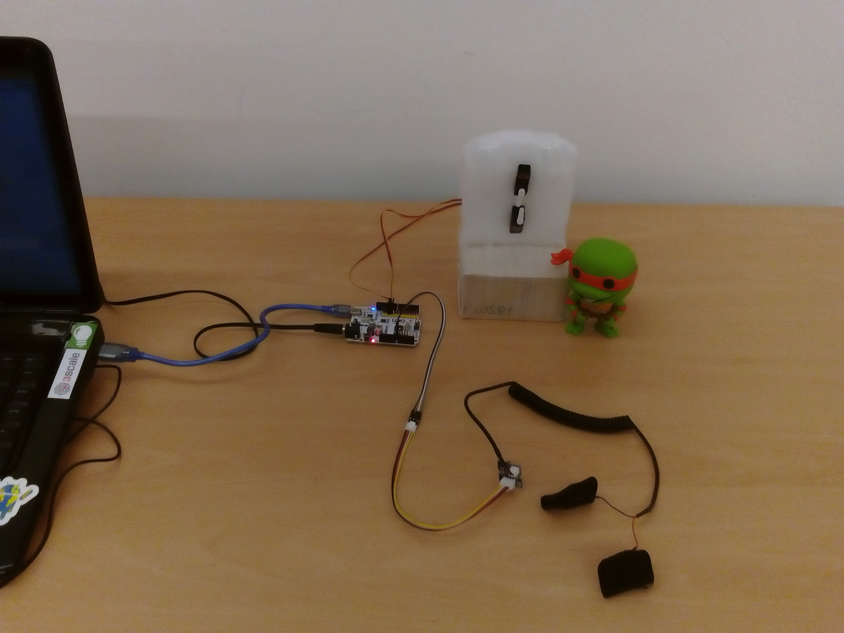
How to do it =
Our Prototype.
Arduino Uno + Servo Motors + Grove GSR Sensor.

Slide 5
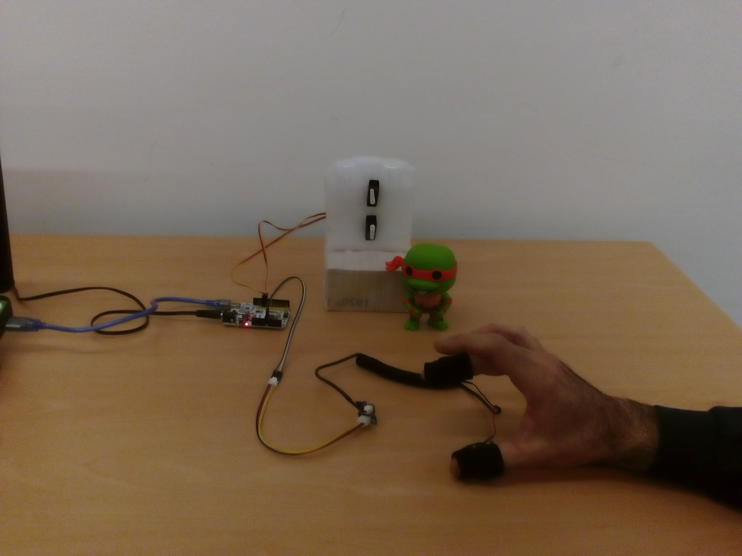
- It works !!!

Slide 6
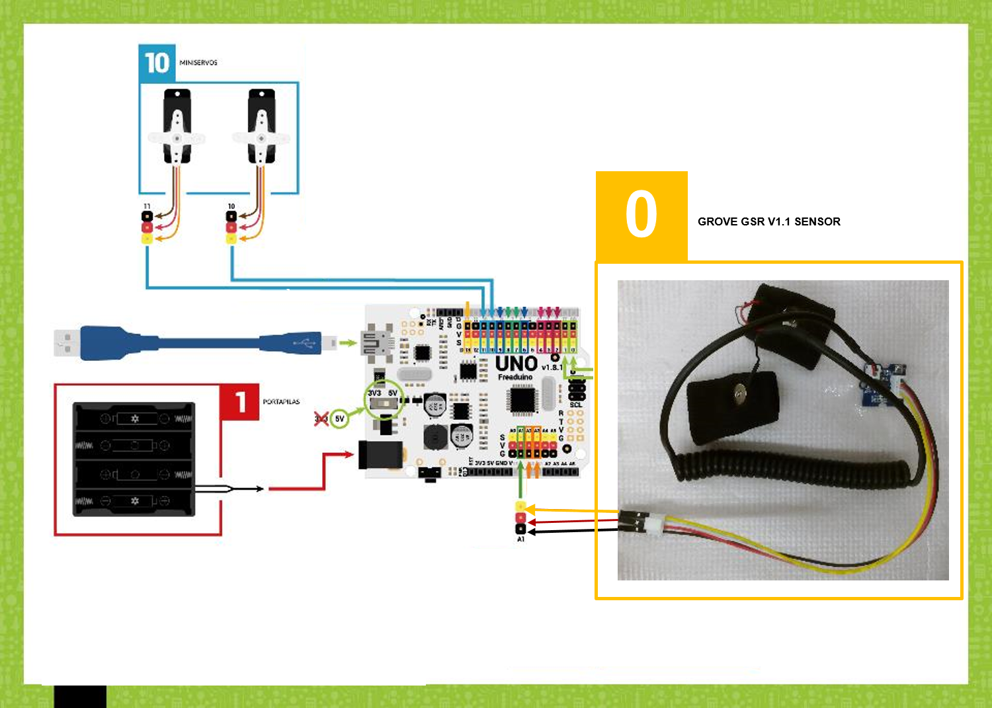
Electrical schematics.
code and all info in github

Slide 7
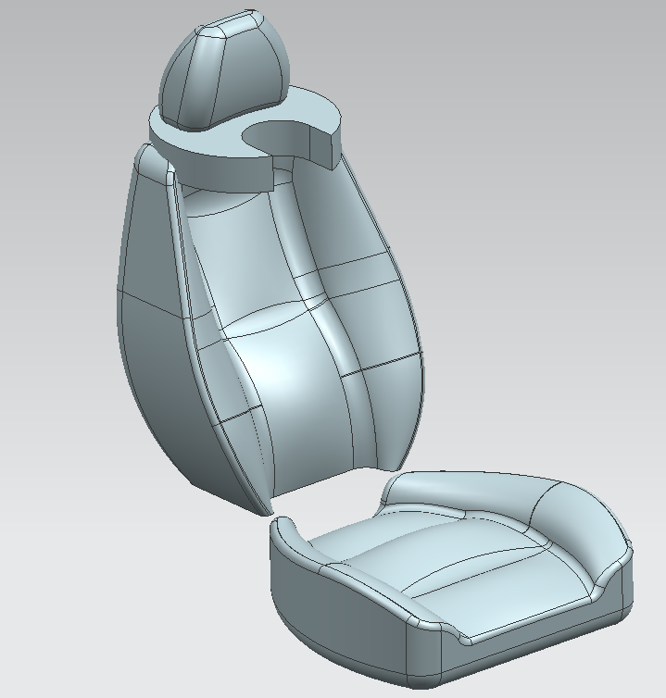
Our Seat Design for SEAT.
we take care of your neck.

Slide 8
Health Vital Signs are the new Big Trend.
We can take profit of Vital Health Signs to
automate processes and to improve Our
Quality of Life.
When you are stressed, your hands sweat more and we take profit of this info, in order to give a massage to you in a traffic jam.

Slide 9
- When you are in a Traffic Jam, Sensors in the steering wheel, they will activate a massage for you. - Some servo motors in your seat, will give you a comfortable massage for you.

Slide 10
DEMO Time and/or Video.

Slide 11
Massage.
Thank you and Questions??...
Team: Aixeraff, Alberto, Josep Maria and Josep

